Slide 1
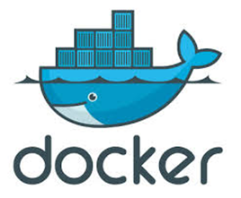
Docker Container
A brief Introduction (Gurgaon, 30-Jan-2016)

Slide 2
Agenda
What is Docker?
Build apps once, run anywhere !
VM versus Containers
(Enabling) Platform for distributed apps!
Design & Technology
Introduction
Docker Architecture
Hands-on usage demonstration

Slide 3
Build once, RUN anywhere…
What is Docker?

Slide 4
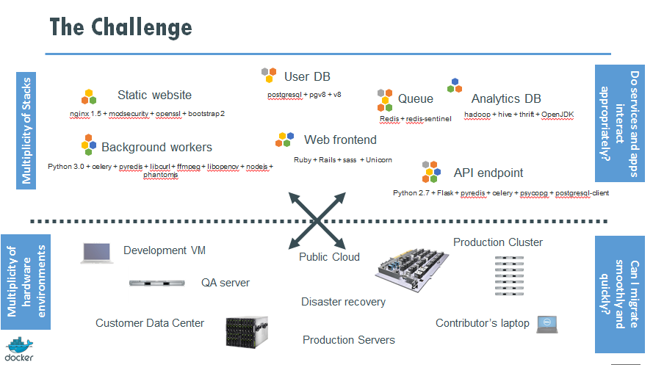
Challenge of Software Industry
Source: http://www.slideshare.net/Docker/dockerintronovember-131125185628phpapp02-37588934

Slide 5
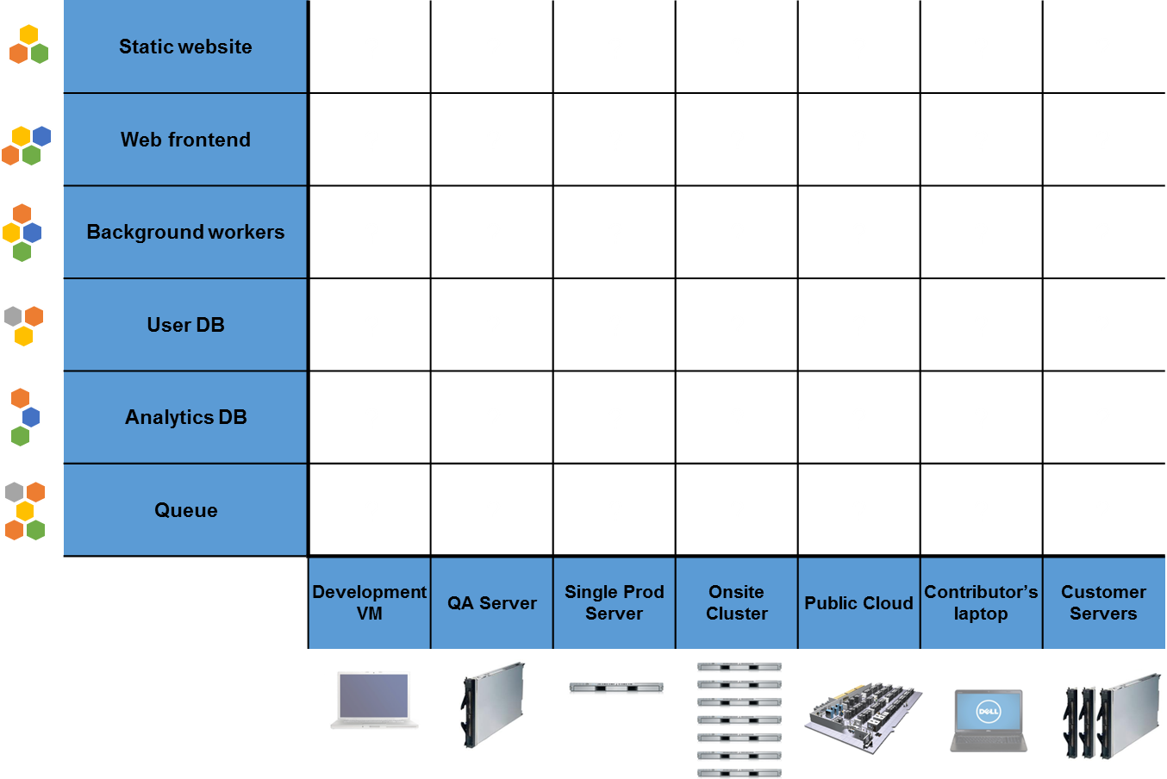
Dependency Hell (libraries / packages / ….)
Source: http://www.slideshare.net/Docker/dockerintronovember-131125185628phpapp02-37588934

Slide 6
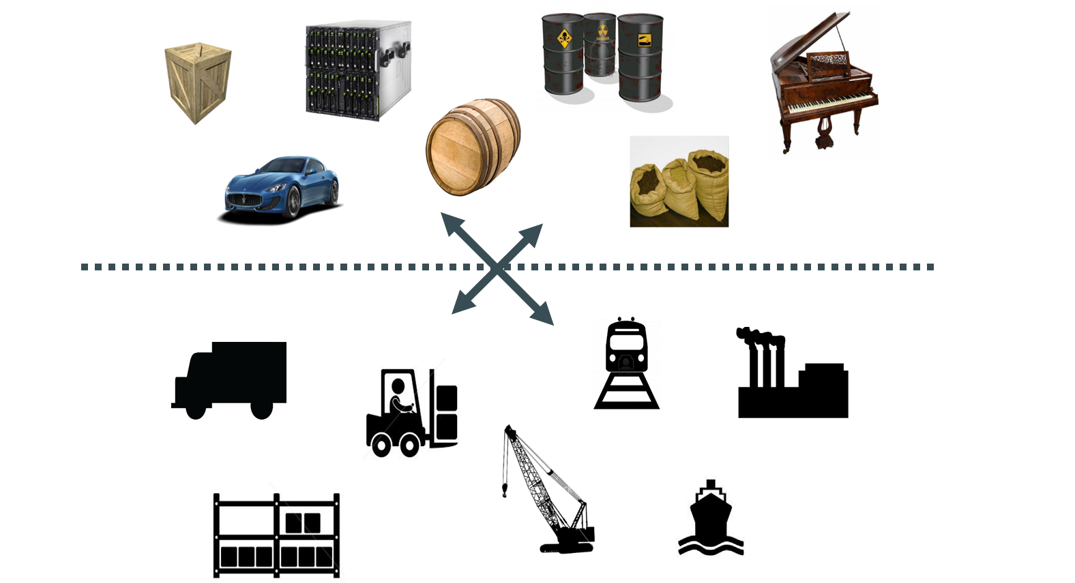
Cargo transport (pre-1960….)
Source: http://www.slideshare.net/Docker/dockerintronovember-131125185628phpapp02-37588934

Slide 7
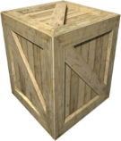
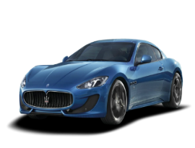
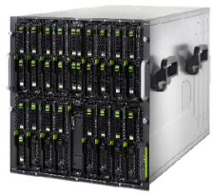
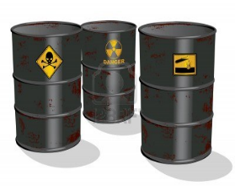
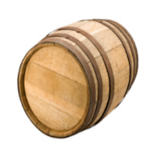
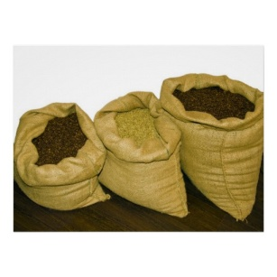
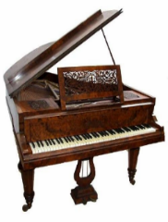
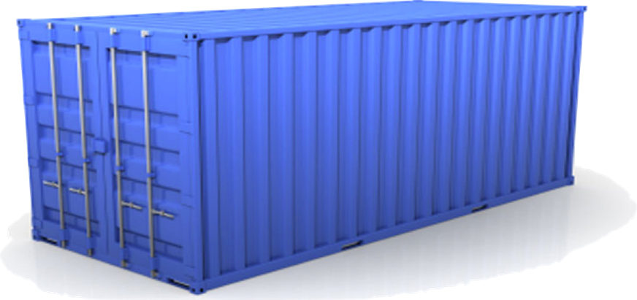
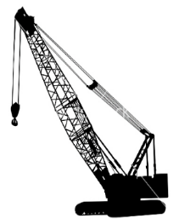
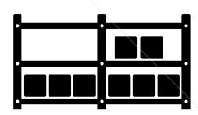
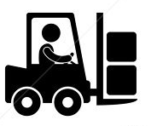




Solution for Shipping Industry….
Do I worry about how goods interact (e.g. coffee beans next to spices)
Multiplicity of Goods
A standard container that is loaded with virtually any goods, and stays sealed until it reaches final delivery.
…in between, can be loaded and unloaded, stacked, transported efficiently over long distances, and transferred from one mode of transport to another
Multiplicity of methods for transporting/storing
Can I transport quickly and smoothly
(e.g. from boat to train to truck)
Source: http://www.slideshare.net/Docker/dockerintronovember-131125185628phpapp02-37588934

Slide 8
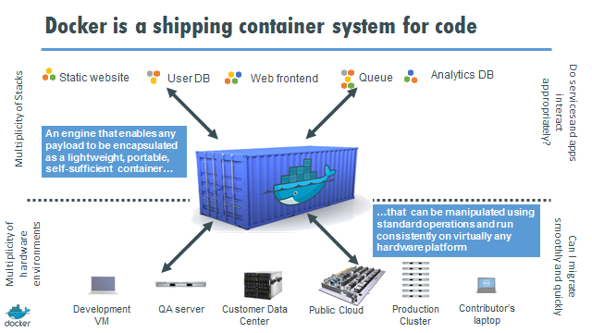
Solution
Source: http://www.slideshare.net/Docker/dockerintronovember-131125185628phpapp02-37588934

Slide 9
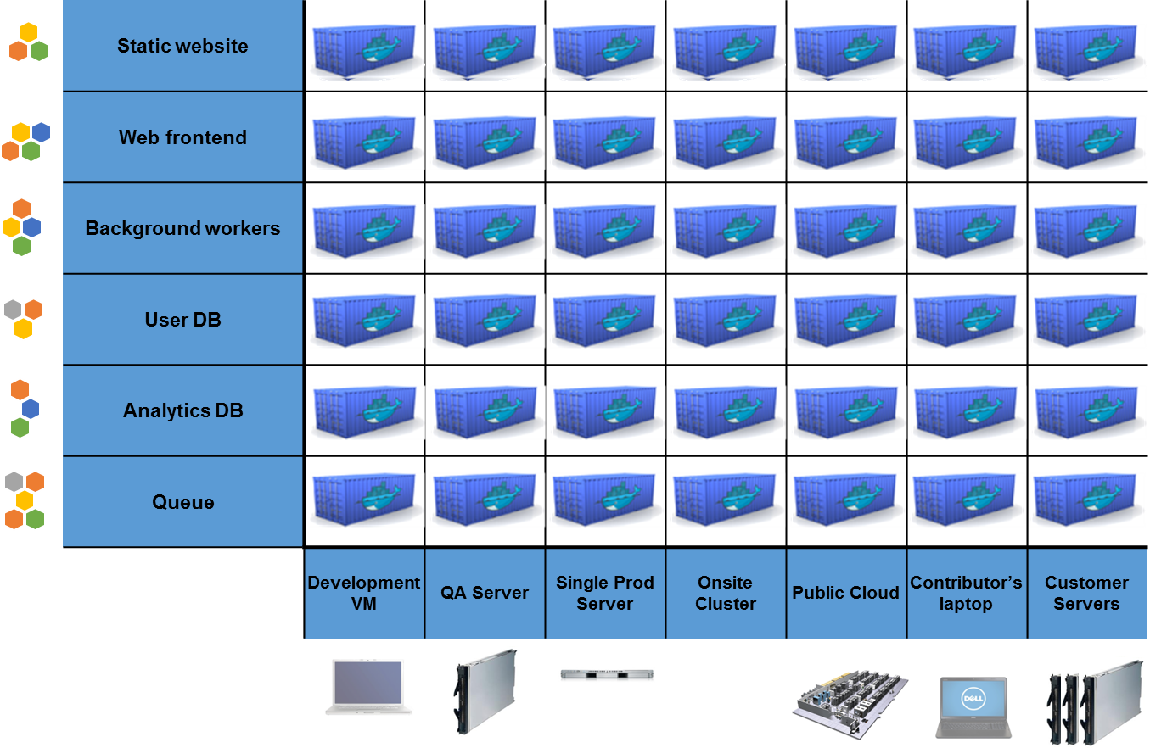
Solution for Software Industry….
Source: http://www.slideshare.net/Docker/dockerintronovember-131125185628phpapp02-37588934

Slide 10
Hypervisor VM versus Docker Containers
Virtual Machine (Hardware virtualization)
Includes hardware simulation & OS execution
Docker containers
(OS level virtualization)
Based on Linux Containers and Union File System.
Requires order of few MBs of memory for each instance (Light Weight)
Instance launched in sub-second time-frame (much faster)
Requires order of GB – 100s of MBs of memory for each instance (Heavy Weight)
Can simulate few VMs per server (Expensive)
Instance launch complete takes several seconds minute (slower)
Can simulate much higher containers per server (Cheaper)

Slide 11
Enabling Platform for distributed computing….
Found new areas of application

Slide 12
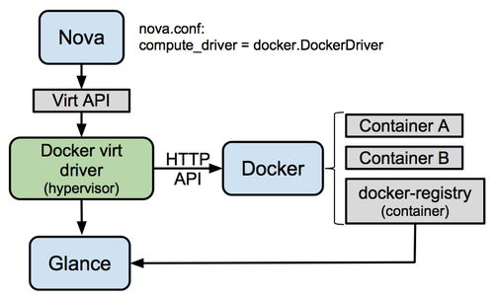
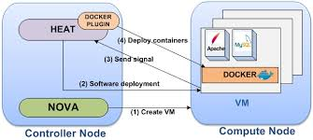
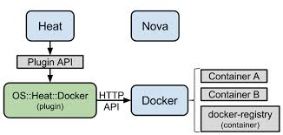
Enabling Cloud Computing (OpenStack)

Slide 13

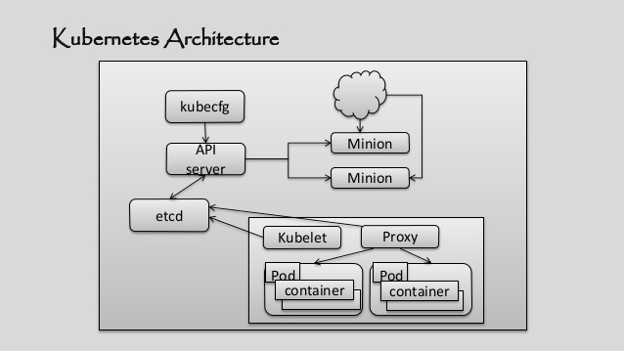
Enabling Distributed computing (Google Kubernetes)

Slide 14
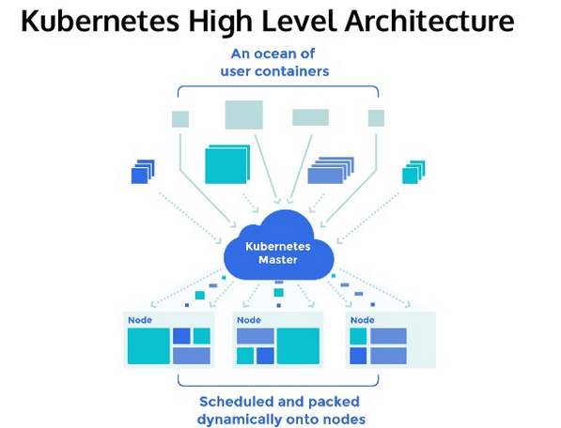
Kubernetes HLA

Slide 15
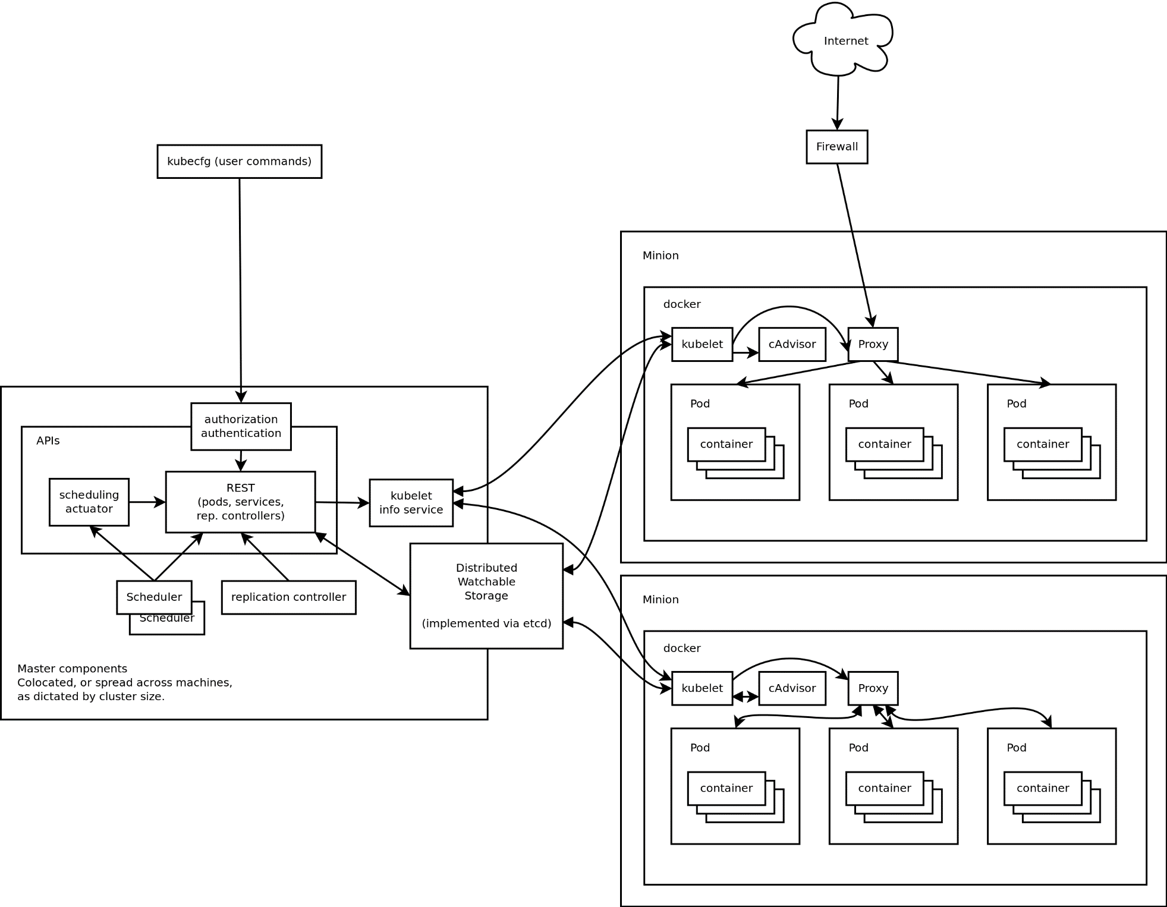

Slide 16
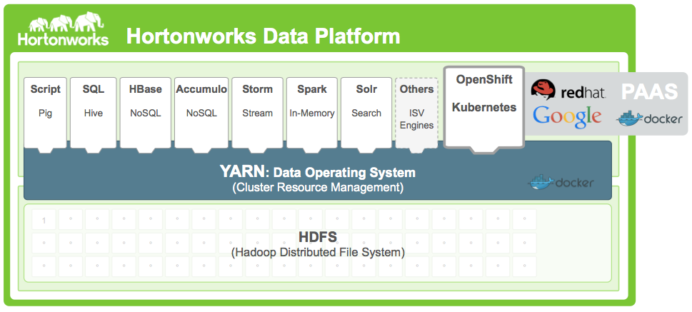
Enabling Hadoop (Distributed computing platform)
Notes:
http://hortonworks.com/blog/openshift-v3-kubernetes-docker-hadoop-yarn/

Slide 17
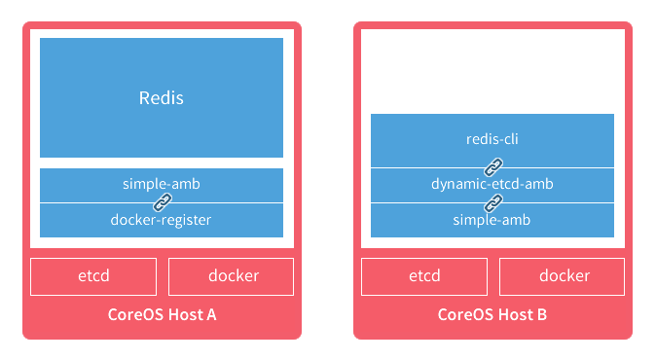
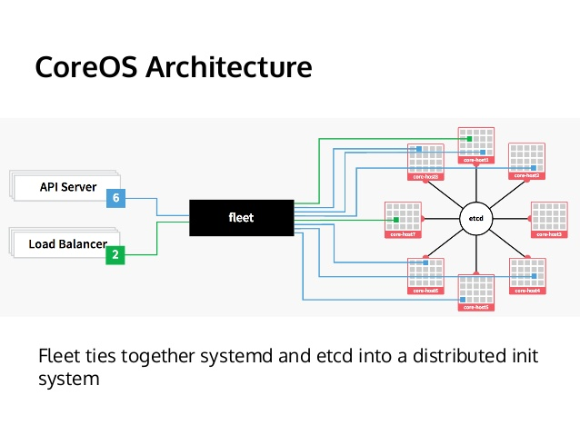
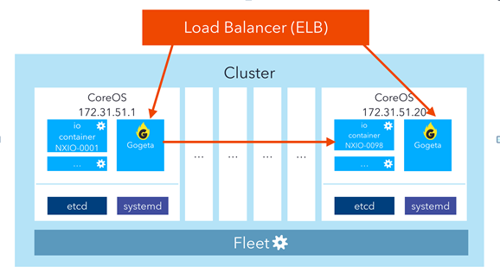
CoreOS
Gogeta

Slide 18
Design & Technology
What is Docker?

Slide 19
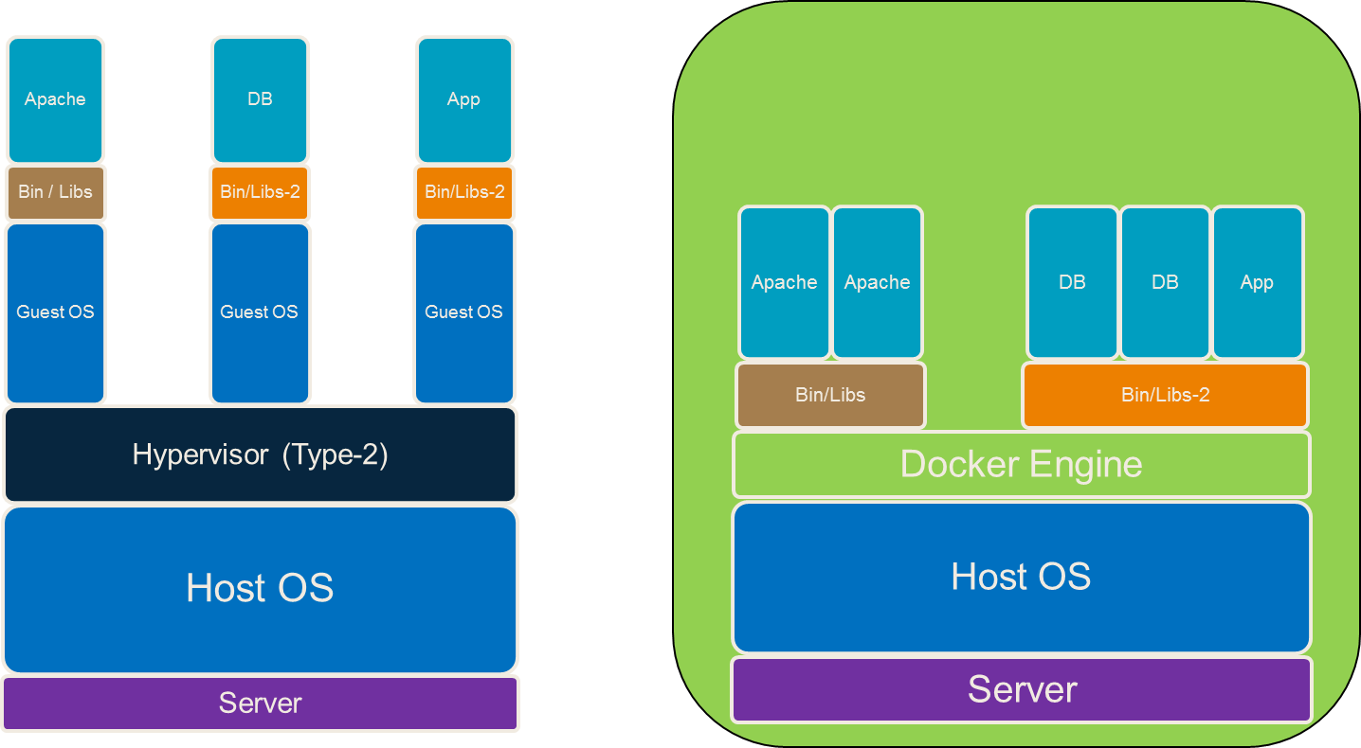
Docker Technology : Introduction
Framework built on top of Linux containers that can package an application and its dependencies => Can be launched / deployed in form of software container on any Linux server (providing portability of underlying platform: cloud, bare-metal, server, desktop or laptop)
Traditional Hypervisor based VMs
Container based Application execution

Slide 20


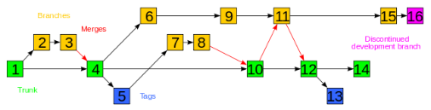
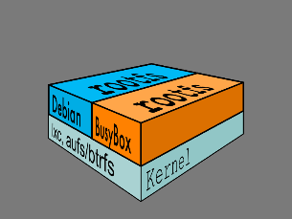
Docker Technology Introduction….continued…
Container relies on Linux kernel facilities: chroot, cgroups and name-space facilities that provide resource isolation (CPU, memory, block I/O, network, etc.) => Doesn’t require a separate OS instance.
Docker uses AUFS (Advanced multi-layered Unification File System) – It greatly enhances the performance of docker containers and provides for optimized usage of underlying disk resources
Docker provides versioning capability to track successive versions of a container
Docker provides framework & a high level API over Linux containers for portable deployment of applications across machines

Slide 21
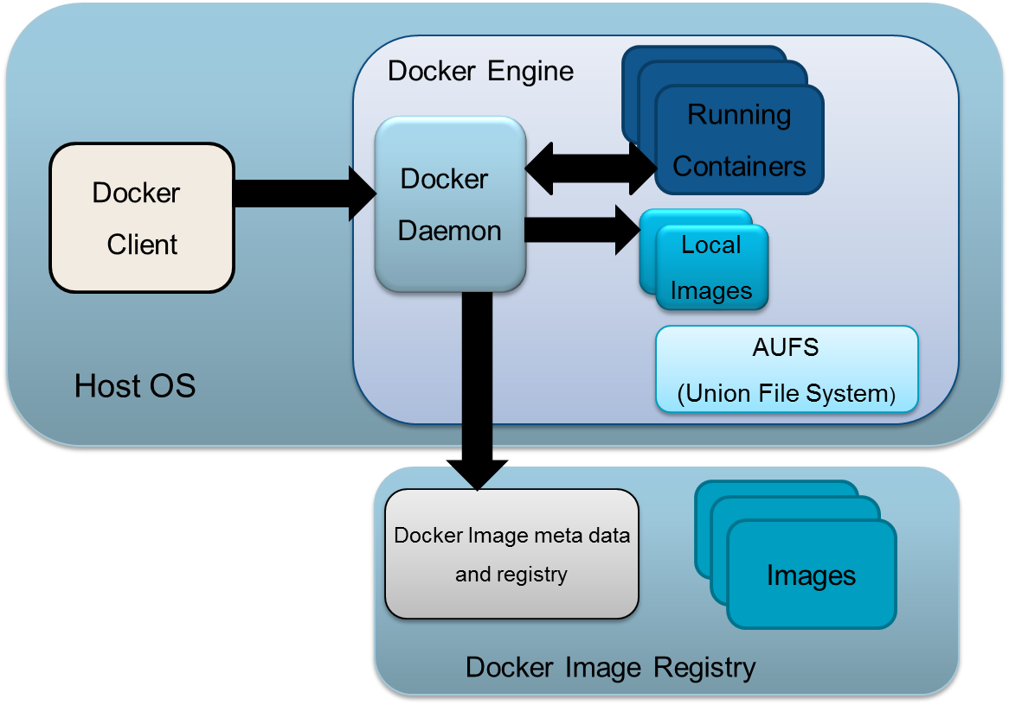
Docker Architecture

Slide 22
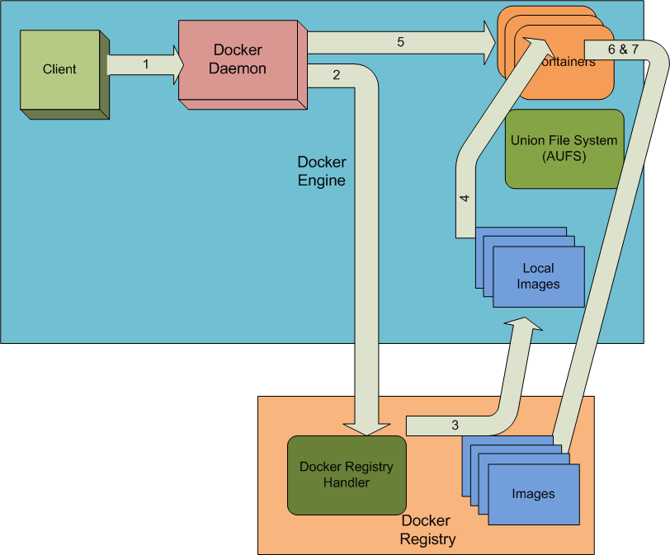
Usage Flow

Slide 23
Docker Platform for Distributed computing….
Docker Machine
Docker Machine takes you from zero-to-Docker in seconds with a single command.
Before Docker Machine, a developer would need to log in to the host and follow installation and configuration instructions specifically for that host and its OS. With Docker Machine, whether provisioning the Docker daemon on a new laptop, on virtual machines in the data center, or on a public cloud instance, the same, single command
Docker Swarm
Docker Swarm is native clustering for Dockerized distributed apps. It picks-up where Docker Machines leaves off by optimizing host resource utilization and providing failover services. Specifically, Docker Swarm allows users to create resource pools of hosts running Docker daemons and then schedule Docker containers to run on top, automatically managing workload placement and maintaining cluster state.
Docker Compose
Docker Compose is the last piece of the orchestration puzzle. After provisioning Docker daemons on any host in any location with Docker Machine and clustering them with Docker Swarm, users can employ Docker Compose to assemble multi-container distributed apps that run on top of these clusters.

Slide 24
Hands-on demonstration
Docker enviornment

Slide 25
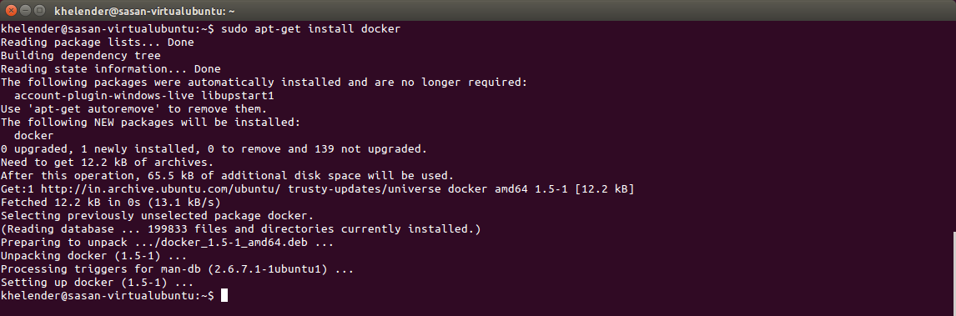
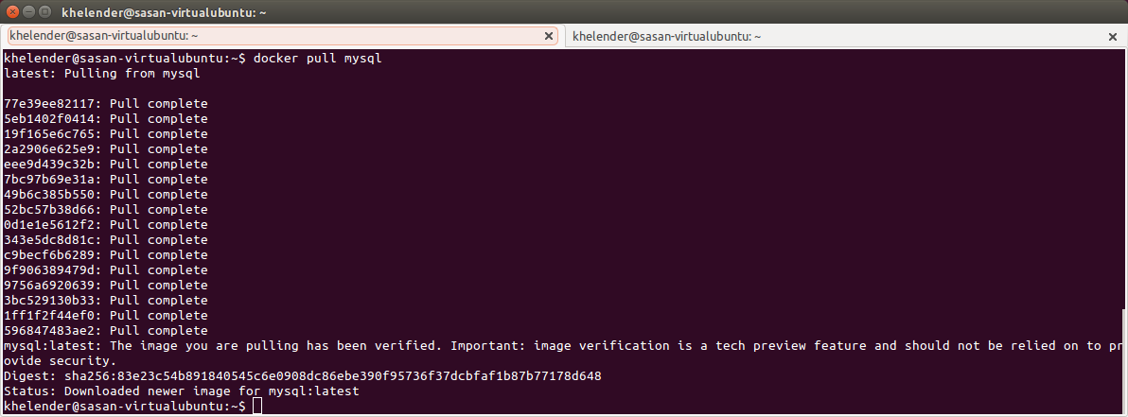
Setting it up and downloading a sample image…
Docker installation
Download an existing container image from public docker registry

Slide 26
A simple 2 linked Container setup…
Server
Docker Engine
Bin/Libs
Bin/Libs-2
Host OS
Etherlite
mysql
Etherlite

Slide 27
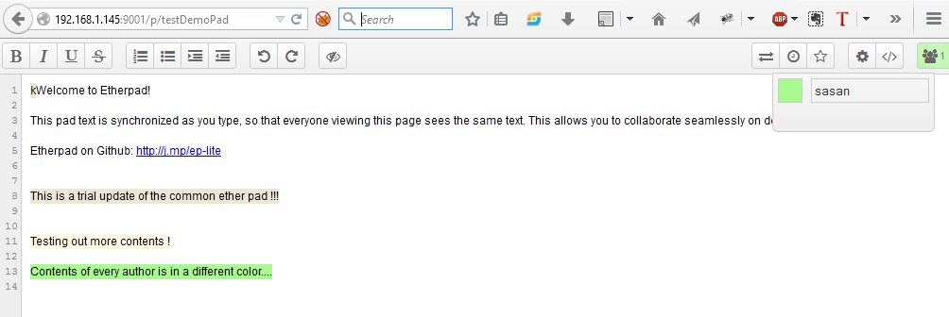
A simple 2-tier web application (ether-lite)
$ mkdir demo
$ cd demo
$ mkdir mysql_data
$ docker run -d -e MYSQL_ROOT_PASSWORD=password --name demo_mysql -v $PWD/mysql_data:/var/lib/mysql mysql
<Container ID>
$ docker run -d --link=demo_mysql:mysql -p 9001:9001 mkodockx/docker-etherpad
<Container ID>
<<< Another instance for scaling can be added as well !!>>>
$ docker run -d --link=demo_mysql:mysql -p 9002:9001 mkodockx/docker-etherpad

Slide 28
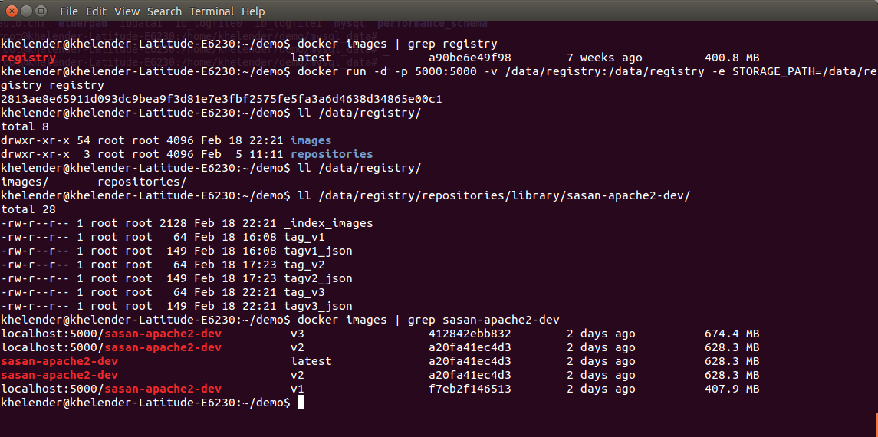
Explaning Registry Server…

Slide 29
Thanks! Questions?

